Slide 1
Adapted from Samira Khan, University of Virginia
COMPUTER ARCHITECTURE
CS 6354
Prefetching
Samira Khan
University of Virginia
April 26, 2016
The content and concept of this course are adapted from CMU ECE 740

Slide 2
Prefetching
Idea: Fetch the data before it is needed (i.e. pre-fetch) by the program
Why?
Memory latency is high. If we can prefetch accurately and early enough we can reduce/eliminate that latency.
Can eliminate compulsory cache misses
Can it eliminate all cache misses? Capacity, conflict?
Involves predicting which address will be needed in the future
Works if programs have predictable miss address patterns

Slide 3
Basics
In modern systems, prefetching is usually done in cache block granularity
Prefetching is a technique that can reduce both
Miss rate
Miss latency
Prefetching can be done by
hardware
compiler
programmer

Slide 4
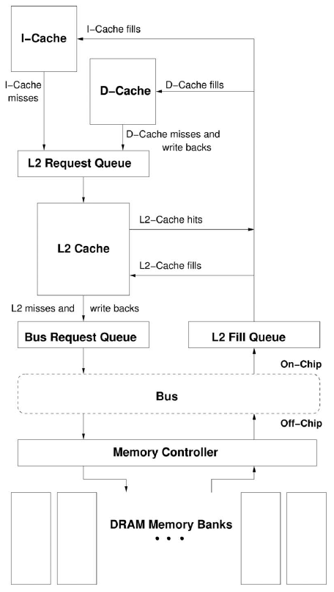
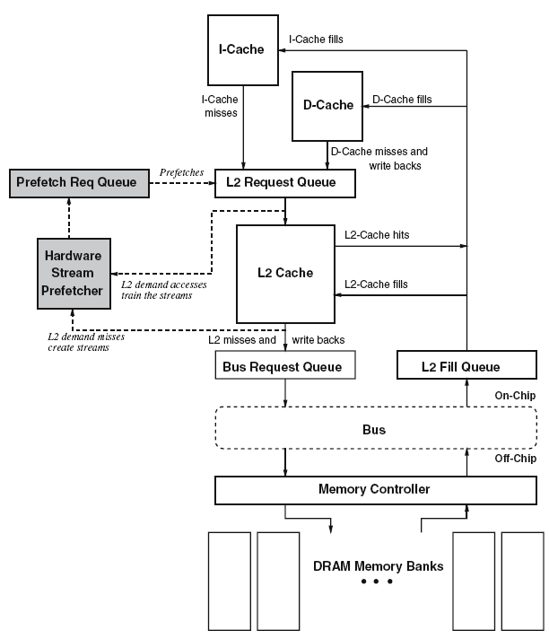
How a HW Prefetcher Fits in the Memory System

Slide 5
Prefetching: The Four Questions
What
What addresses to prefetch
When
When to initiate a prefetch request
Where
Where to place the prefetched data
How
Software, hardware, execution-based, cooperative

Slide 6
Challenges in Prefetching: What
What addresses to prefetch
Prefetching useless data wastes resources
Memory bandwidth
Cache or prefetch buffer space
Energy consumption
Accurate prediction of addresses to prefetch is important
Prefetch accuracy = used prefetches / sent prefetches
How do we know what to prefetch
Predict based on past access patterns
Use the compiler’s knowledge of data structures
Prefetching algorithm determines what to prefetch

Slide 7
Challenges in Prefetching: When
When to initiate a prefetch request
Prefetching too early
Prefetched data may be evicted before use
Prefetching too late
Might not hide the whole memory latency
When a data item is prefetched affects the timeliness of the prefetcher
Prefetcher can be made more timely by
Making it more aggressive: try to stay far ahead of the processor’s access stream (hardware)
Moving the prefetch instructions earlier in the code (software)

Slide 8
Challenges in Prefetching: Where (I)
Where to place the prefetched data
In cache
+ Simple design, no need for separate buffers
-- Can evict useful demand data → cache pollution
In a separate prefetch buffer
+ Demand data protected from prefetches → no cache pollution
-- More complex memory system design
- Where to place and how to size the prefetch buffer
- When to access the prefetch buffer (parallel vs. serial with cache)
- When to move the data from the prefetch buffer to cache
Many modern systems place prefetched data in the cache
Intel Pentium 4, Core2’s, AMD systems, IBM POWER4,5,6,

Slide 9
Challenges in Prefetching: Where (II)
Where to place the prefetched data in the cache?
Do we treat prefetched blocks the same as demand-fetched blocks?
Prefetched blocks are not known to be needed
With LRU, a demand block is placed into the MRU position
Do we skew the replacement policy such that it favors the demand-fetched blocks?
E.g., place all prefetches into the LRU position in a way?
Which level of cache to prefetch into?
Memory to L2, memory to L1. Advantages/disadvantages?
L2 to L1? (a separate prefetcher between levels)

Slide 10
Prefetcher Performance
Prefetch Accuracy
Ratio of prefetch hits to number of prefetches
Higher accuracy => better performance, less wasted resources!
Prefetch Coverage
Fraction of original misses eliminated by prefetched lines; that is ratio of prefetch hits to number of misses (without prefetching)
Higher coverage is important for prefetchto be effective
Timeliness
A prefetch is timely is the prefetch request is completed and the data are placed in cache, and not evicted by other requests
Ratio of on-time prefetches / useful prefetches

Slide 11
Prefetcher Parameters
For most hardware prefetchers:
Prefetch distance: how far ahead of the demand stream
Prefetch degree: how many prefetches per demand access
Access Stream
Prefetch Degree
X
X+1
Predicted Stream
1 2 3
(X+P)
Prefetch
Distance

Slide 12
Challenges in Prefetching: How
Software prefetching
ISA provides prefetch instructions
Programmer or compiler inserts prefetch instructions (effort)
Usually works well only for “regular access patterns”
Hardware prefetching
Hardware monitors processor accesses
Memorizes or finds patterns/strides
Generates prefetch addresses automatically
Execution-based prefetchers
A “thread” is executed to prefetch data for the main program
Can be generated by either software/programmer or hardware

Slide 13
Software Prefetching
Idea: Compiler/programmer places prefetch instructions into appropriate places in code
Mowry et al., “Design and Evaluation of a Compiler Algorithm for Prefetching,” ASPLOS 1992.
Prefetch instructions prefetch data into caches
Compiler or programmer can insert such instructions into the program

Slide 14
Software Prefetching (II)
for (i=0; i<N; i++) {
__prefetch(a[i+8]);
__prefetch(b[i+8]);
sum += a[i]*b[i];
}
while (p) {
__prefetch(p→next);
work(p→data);
p = p→next;
}
while (p) {
__prefetch(p→next→next→next);
work(p→data);
p = p→next;
}
Can work for very regular array-based access patterns. Issues:
-- Prefetch instructions take up processing/execution bandwidth
How early to prefetch? Determining this is difficult
-- Prefetch distance depends on hardware implementation (memory latency, cache size, time between loop iterations) → portability?
-- Going too far back in code reduces accuracy (branches in between)
Need “special” prefetch instructions in ISA?
Alpha load into register 31 treated as prefetch (r31==0)
PowerPC dcbt (data cache block touch) instruction
-- Not easy to do for pointer-based data structures
Which one is better?

Slide 15
Hardware Prefetching
Idea: Specialized hardware observes load/store access patterns and prefetches data based on past access behavior
Tradeoffs:
+ Can be tuned to system implementation
+ Does not waste instruction execution bandwidth
-- More hardware complexity to detect patterns

Slide 16
Next-Line Prefetchers
Simplest form of hardware prefetching: always prefetch next N cache lines after a demand access (or a demand miss)
Next-line prefetcher (or next sequential prefetcher)
Tradeoffs:
+ Simple to implement. No need for sophisticated pattern detection
+ Works well for sequential/streaming access patterns
-- Inaccurate with irregular patterns and wastes bandwidth
-- And, even regular patterns:
- What is the prefetch accuracy if access stride = 2 and N = 1?
- What if the program is traversing memory from higher to lower addresses?
- Also prefetch “previous” N cache lines?

Slide 17
Stride Prefetchers
Two kinds
Instruction program counter (PC) based
Cache block address based
Instruction based:
Baer and Chen, “An effective on-chip preloading scheme to reduce data access penalty,” SC 1991.
Idea:
Record the distance between the memory addresses referenced by a load instruction (i.e. stride of the load) as well as the last address referenced by the load
Next time the same load instruction is fetched, prefetch last address + stride

Slide 18
Instruction Based Stride Prefetching
Load PC
Effective Addr.
-
Load Inst. Tag | Last Address | Last Stride | Confidence
……. | ……. | …… | ……
+
Late prefetches
Prefetch ahead (last address + N*stride)
Generate multiple prefetches
How far can the prefetcher get ahead of demand accesses? Use lookahead PC to index the prefetcher table
Prefetch
Address

Slide 19
Cache Address Based Stride Prefetching
Can detect
A, A+N, A+2N, A+3N, …
Stream buffers are a special case of cache block address based stride prefetching where N = 1
Effective Addr.
-
Last Address | Last Stride | Confidence
……. | …… | ……
+
Prefetch
Address

Slide 20
Stream Buffers (Jouppi, ISCA 1990)
Each stream buffer holds one stream of sequentially prefetched cache lines
On a load miss check the head of all stream buffers for an address match
if hit, pop the entry from FIFO, update the cache with data
if not, allocate a new stream buffer to the new miss address (may have to recycle a stream buffer following LRU policy)
Stream buffer FIFOs are continuously topped-off with subsequent cache lines whenever there is room and the bus is not busy
FIFO
FIFO
DCache
Memory interface
FIFO
FIFO
Jouppi, “Improving Direct-Mapped Cache Performance by the Addition of a Small Fully-Associative Cache and Prefetch Buffers,” ISCA 1990.

Slide 21
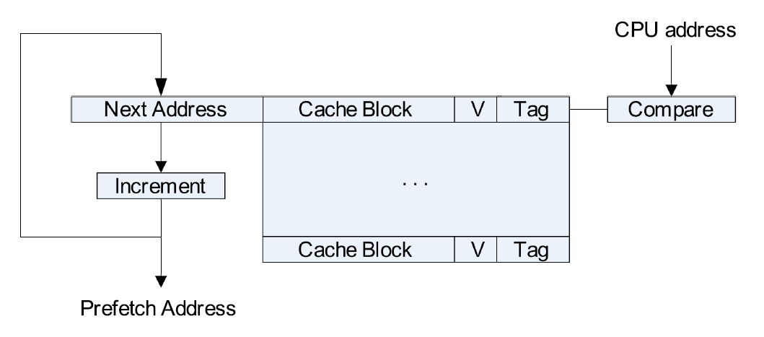
Stream Buffer Design

Slide 22
Prefetching Using a Global History Buffer
Adapted from K.J.Nesbit’s Talk
Kyle J. Nesbit and James E. Smith

Slide 23
Markov Prefetching
Markov prefetching forms address correlations
Joseph and Grunwald (ISCA ‘97)
Uses global memory addresses as states in the Markov graph
Correlation Table approximates Markov graph
Miss Address Stream
A B C A B C B C . . .
Markov Graph
Correlation Table
1
1st predict.
2nd predict.
A
B
miss
address
A
B
.5
B
C
1
C
B
A
.5
C

Slide 24
Correlation Prefetching
Distance Prefetching forms delta correlations
Kandiraju and Sivasubramaniam (ISCA ‘02)
Delta-based prefetching leads to much smaller table than “classical” Markov Prefetching
Delta-based prefetching can remove compulsory misses
Markov Prefetching
Distance Prefetching
Miss Address Stream
Global Delta Stream
27 28 29 27 28 29 28 29
1 1 -2 1 1 -1 1
miss
address
1st predict.
2nd predict.
global
delta
1st predict.
2nd predict.
27
28
-2
1
28
29
-1
1
29
28
29
1
-1
-2
Notes:
Fixme: update correlation table – make fonts larger in example

Slide 25
Prefetching using Global History Buffer (GHB): Motivation
Table-based prefetch predictors are inefficient
Reserve fixed amount of space per prefetch key
Stale entries in the table corpg. to old history → lead to ineffective prefetch!
Unifying structure for seemingly different predictors
PC-based constant stride
Markov Prefetch
Distance (Delta) Prefetch

Slide 26
Global History Buffer (GHB)
Holds miss address history in FIFO order
Linked lists within GHB connect related addresses
Same static load
Same global miss address
Same global delta
Global History Buffer
Index Table
Load PC
Index Table
Accessed with a key
Load PC, Miss address, or Delta’s
Used for Localization/Otherwise
FO
FI
miss addresses

Slide 27
GHB – Example (Markov Prefetching)
Miss Address Stream
27 28 29 27 28 29 28
29
Index Table
Global History Buffer
pointer
miss address
pointer
27
27
Global Miss
Address
28
28
29
29
27
28
head pointer
29
28
29
Key
=> Current
=> Prefetches
Notes:
Change addresses to be consistent – make numbers larger, darker

Slide 28
Prefetch Taxonomy
To simplify the discussion and illustrate the relation between prefetching methods we introduce a consistent naming convention.
Each name is a X/Y pair.
X is the key used for localizing the address stream.
Y is the method for detecting address patterns.

Slide 29
Prefetch Taxonomy
We study two localizing methods
Program Counter (PC)
No localization or global (G)
And three pattern detection methods
Address Correlation
Delta Correlation
Constant Stride

Slide 30
Existing Prefetch Methods in Prefetch Taxonomy
Markov Prefetching - G/AC
Distance Prefetching - G/DC
Stride Prefetching - PC/CS

Slide 31
GHB – Example (PC-based Stride Prefetching)
Miss Address Stream for PC2: A, A+s, A+2s, …
Global Miss Address Stream: A, (C-j), A+s, (B-k), B, (C-i), C, A+2s, …
Index Table
Global History Buffer
pointer
miss address
pointer
Load PC
PC1
PC2
A
PC3
B
A+s
head pointer
C
A+2s
Notes:
Change addresses to be consistent – make numbers larger, darker

Slide 32
Prefetching: Width, Depth, and Hybrid
Miss Address Stream
27 28 36 44 45 49 53 54 62 70
71
Global Delta Stream
1 8 8 1 4 4 1 8 8
1
Markov Graph
Hybrid
Width
Depth
.3
.7
1
.7
4
1
8
.7
8
4
.3
.3
8
Prefetches
4
71 + 8 => 79
Key
Prefetches
Prefetches
=> Current
71 + 8 => 79
71 + 4 => 75
71 + 4 => 75
=> Prefetches
79 + 8 => 87
79 + 4 => 79
Notes:
Add absolute prefetch addresses

Slide 33
GHB – Hybrid Delta
Width prefetching suffers from poor accuracy and short look-ahead
Depth prefetching has good look-ahead, but may miss prefetch opportunities when a number of “next” addresses have similar probability
The hybrid method combines depth and width

Slide 34
GHB - Hybrid Example
Miss Address Stream
27 28 36 44 45 49 53 54 62 70
71
Global Delta Stream
1 8 8 1 4 4 1 8 8
1
Global
Delta
Index Table
Global History Buffer
pointer
miss address
pointer
1
27
1
4
28
36
8
8
8
Prefetches
44
71 + 4 => 75
45
71 + 8 => 79
49
4
4
79 + 4 => 79
head pointer
53
79 + 8 => 87
54
8
62
8
70
Key
71
=> Current
=> Prefetches

Slide 35
Simulation Methodology
Simulated SPEC CPU2000 benchmarks
Fast forwarded 1 billion instructions and simulated 1 billion instructions
Used peak binaries compiled -O4 optimization
Results include all benchmarks that have at least a 5% IPC improvement with an ideal L2 cache
Issue Width | 4 Instructions
Load Store Queue | 64 Entries
RUU Size | 128 Entries
Level 1 D-Cache | 16 KB, 2-way
Level 1 I-Cache | 16 KB, 2-way
Level 2 Cache | 512 KB, 4-way
Memory Latency | 140 Cycles

Slide 36
Simulation Methodology
Prefetching Method | Table Configuration | Size
Conventional Distance Prefetching | 512 Table Entries | 18 KB
GHB Distance Prefetching | 512 IT Entries & 512 GHB Entries | 8 KB
Table walk - one cycle per access
IT size reduces table conflicts
GHB size reflects prefetch history working set
In general, the GHB prefetching requires less history

Slide 37
Distance Prefetching (Performance)
35%
Table (width)
GHB (width)
GHB (depth)
GHB (hybrid)
25%
IPC Improvement
15%
5%
1
2
4
8
16
Prefetch Degree

Slide 38
Distance Prefetching (Performance)
110%
Table (width)
(~300%)
GHB (width)
90%
GHB (depth)
GHB (hybrid)
70%
50%
IPC Improvement
30%
10%
-10%
art
swim
applu
apsi
mcf
twolf
vpr
gap
ammp
lucas
mgrid
galgel
parser
bzip2
hmean
wupwise

Slide 39
Distance Prefetching (Memory Traffic)
180%
Table (width)
GHB (width)
GHB (depth)
150%
GHB (hybrid)
120%
90%
Increase in Memory Traffic
60%
30%
0%
1
2
4
8
16
Prefetch Degree

Slide 41
Content Directed Prefetching (I)
A specialized prefetcher for pointer values
Cooksey et al., “A stateless, content-directed data prefetching mechanism,” ASPLOS 2002.
Idea: Identify pointers among all values in a fetched cache block and issue prefetch requests for them.
+ No need to memorize/record past addresses!
+ Can eliminate compulsory misses (never-seen pointers)
-- Indiscriminately prefetches all pointers in a cache block
How to identify pointer addresses:
Compare address sized values within cache block with cache block’s address → if most-significant few bits match, pointer
Source: Onur Mutlu, CMU, ECE-740, Fall-2011

Slide 42
Content Directed Prefetching (II)
X800
22220
x40373551
x80011100
[31:20]
x800
11100
[31:20]
[31:20]
[31:20]
[31:20]
[31:20]
[31:20]
[31:20]
[31:20]
=
=
=
=
=
=
=
=
Virtual Address Predictor
Generate Prefetch
X80022220
L2
DRAM
…
…
Source: Onur Mutlu, CMU, ECE-740, Fall-2011

Slide 43
Other Prefetching Methods
Somogyi et al., “Spatio-Temporal Memory Streaming,” ISCA 2007.
Idea: Combining spatial and temporal prefetch predictors.
Temporal Predictor: Recurring memory access sequences
Spatial Predictor: Recurring data layouts (structs)
Ishii et al., “Access Map Pattern Matching” Jl. of ILP, 2011
Idea: Captures simple repeating access patterns through an array of 2 bit values.
Shevgoor, et al., “Variable Length Delta Prefetcher”, Micro 2015
Idea: Learns multiple delta sequences from variable length Delta History Buffer (per page)
Data Prefetch Championship, held along with ISCA

